Slide 1






EXPLORING
HUMAN-COMPUTER INTERACTION:
PAST, PRESENT, AND FUTURE
Croitoru Andreea-Bianca gr.222

Slide 2
TABLE OF CONTENTS
Introduction
The Evolution of HCI
Key Components of HCI
Applications of HCI
Challenges in HCI
Future Trends in HCI
Conclusion
3
4
5
6
12
14
17

Slide 3

INTRODUCTION
Human-Computer Interaction (HCI) is a multidisciplinary field that focuses on the design, evaluation, and implementation of interactive computing systems for human use. It examines the ways humans interact with computers and seeks to create systems that are both effective and user-friendly. HCI plays a crucial role in shaping the way people engage with technology, making it an essential aspect of modern computing.

Slide 4

THE EVOLUTION OF HCI
60'S
70'S
NOW
command-line interfaces, which required a deep understanding of programming and syntax
limited to text-based interactions, making them inaccessible to the general population
only experts or highly trained individuals could operate such systems effectively
the introduction of Graphical User Interfaces (GUIs) marked a revolutionary shift
visual elements such as windows, icons, menus, and pointers (WIMP)
computers accessible to a broader audience
the emergence of the mouse and other pointing devices, simplifying interaction and enhancing productivity
natural user interfaces began to emerge, including touchscreens, voice recognition, and gesture-based controls
smartphones and tablets popularised touch-based interactions, while voice-activated assistants like Siri and Alexa made hands-free operation a reality
advancements in virtual reality (VR), augmented reality (AR), and artificial intelligence (AI), providing increasingly intuitive and immersive experiences for users

Slide 5







KEY COMPONENTS OF HCI
DESIGN PRINCIPLES
ACCESSIBILITY
USABILITY
Accessibility ensures that technology is usable by individuals with disabilities. Features like screen readers, voice commands, and adaptive hardware make interfaces inclusive for all users
Usability is at the core of HCI, emphasising simplicity, efficiency, and user satisfaction. Effective design minimizes errors and ensures that users can achieve their goals seamlessly.
A visually appealing interface enhances user engagement. HCI incorporates principles of graphic design, typography, and layout to create attractive and functional interfaces.

Slide 6
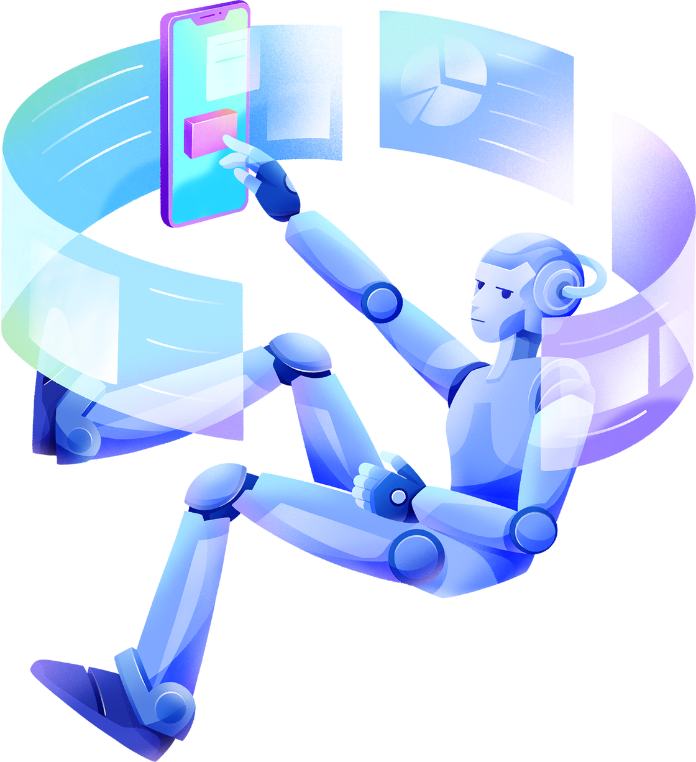

APPLICATIONS OF HCI

Slide 7
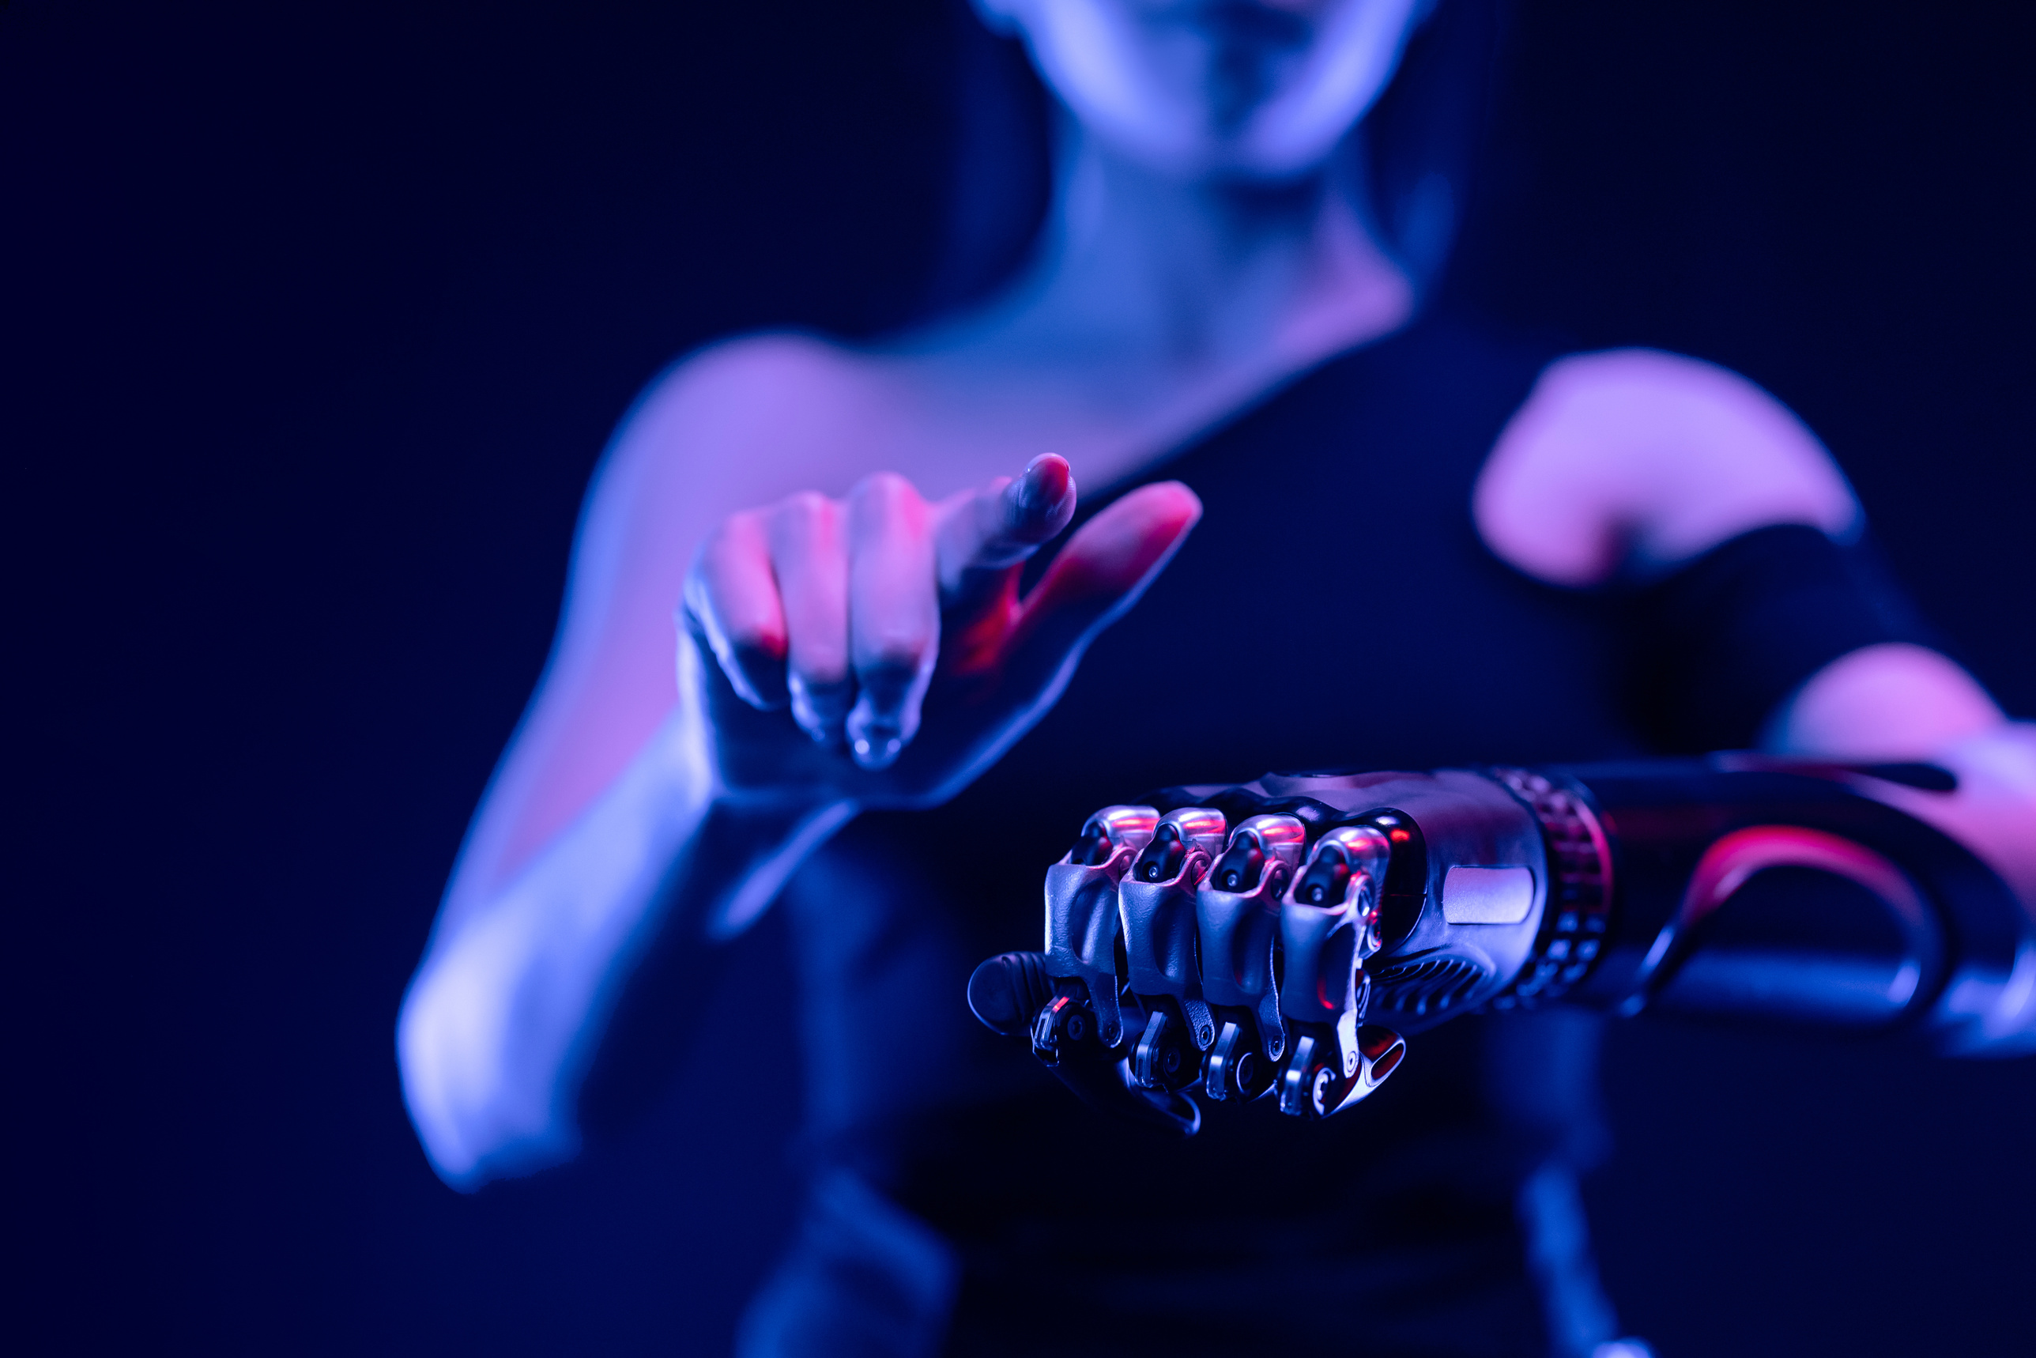
GAMING
HCI has transformed gaming through immersive experiences enabled by Virtual Reality (VR) and Augmented Reality (AR). Interfaces like motion controllers, haptic feedback systems, and headsets have redefined user engagement. These innovations create highly realistic environments that enhance player immersion and interaction

Slide 8

HEALTHCARE
HCI plays a vital role in telemedicine, wearable health devices, and patient monitoring systems. Interfaces designed for medical applications improve access to care, enable remote diagnostics, and support chronic disease management. For example, wearable fitness trackers with user-friendly dashboards help individuals monitor their health metrics in real-time

Slide 9

EDUCATION
E-learning platforms leverage HCI to provide interactive and personalized learning experiences. Features such as adaptive quizzes, multimedia content, and virtual classrooms enhance student engagement and knowledge retention. Additionally, augmented reality (AR) applications allow students to interact with 3D models, making complex concepts easier to understand

Slide 10
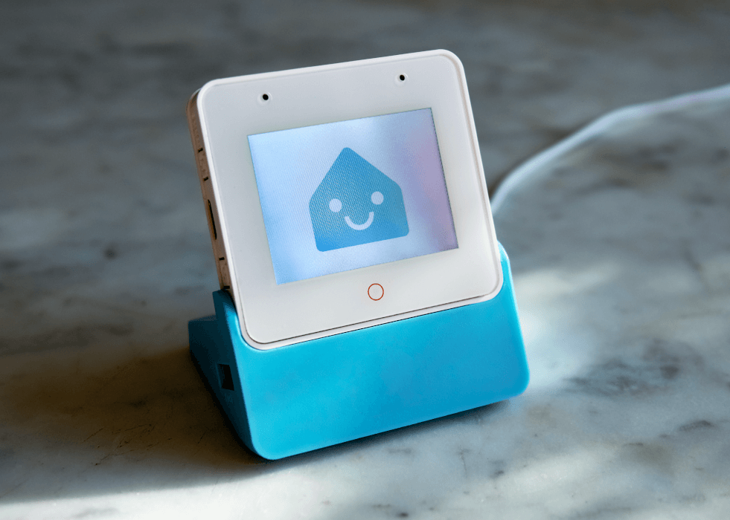
SMART DEVICES AND IOT
HCI enables seamless interaction with Internet of Things (IoT) devices, such as smart thermostats, home assistants, and wearable technology. Through intuitive interfaces and voice commands, users can control their environment and access information effortlessly. For instance, smart home systems allow users to manage lighting, security, and appliances with simple gestures or spoken instructions.

Slide 11
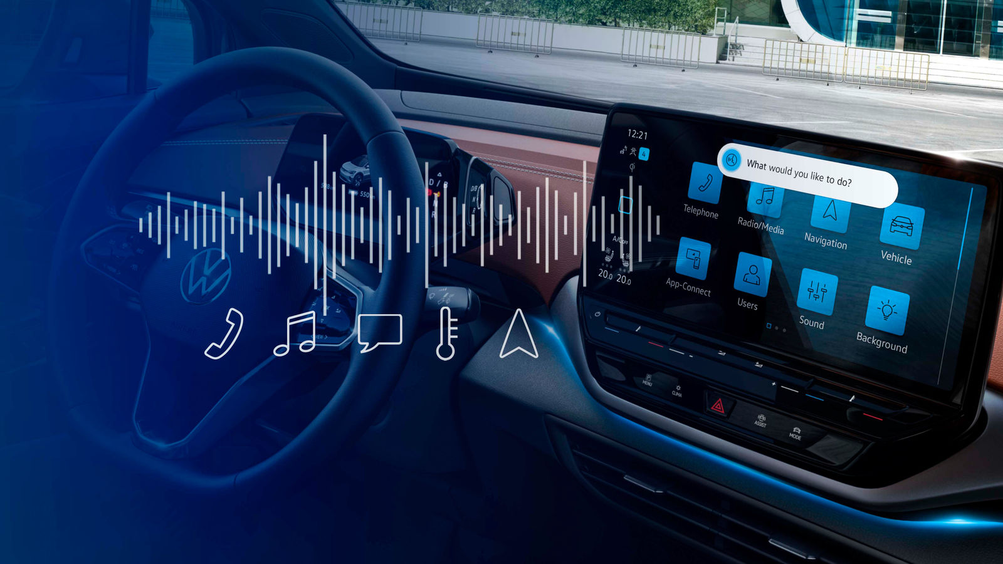
AUTOMOTIVE SYSTEMS
Modern vehicles incorporate HCI principles in their design, offering interfaces such as touchscreens, voice-controlled navigation, and heads-up displays. These systems enhance safety and convenience by reducing driver distraction and providing real-time information

Slide 12

CHALLENGES IN HCI
Designing for Diversity
Creating interfaces that cater to users from varied backgrounds, cultures, and skill levels. This includes considering language differences, cultural preferences, and varying levels of technical expertise
Balancing Simplicity and Functionality
Overly complex interfaces can lead to frustration, while overly simplified ones might lack necessary functionality for power users

Slide 13

Ethical Concerns
Addressing issues such as data privacy, user consent, and algorithmic bias in HCI systems. For example, AI-driven interfaces must avoid perpetuating biases in their recommendations or decision-making processes
As technology becomes more feature-rich, users may struggle to process excessive information. Designers must find ways to present information effectively without overwhelming the user
Cognitive Overload
Adapting to Emerging Technologies
As new technologies such as AR, VR, and BCIs evolve, HCI must adapt to address novel interaction paradigms and technical challenges

Slide 14
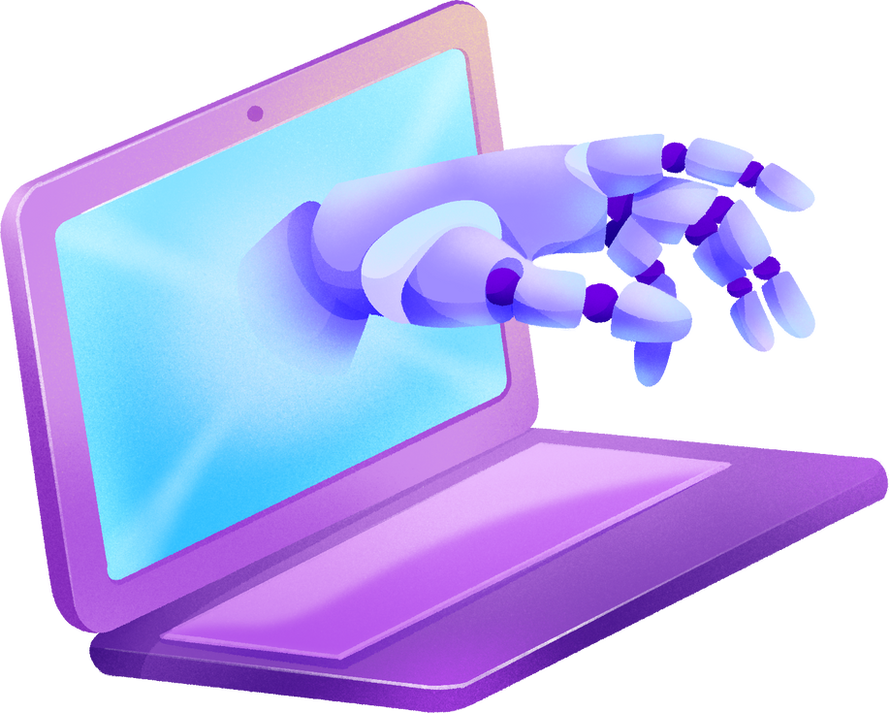
FUTURE TRENDS IN HCI

Slide 15




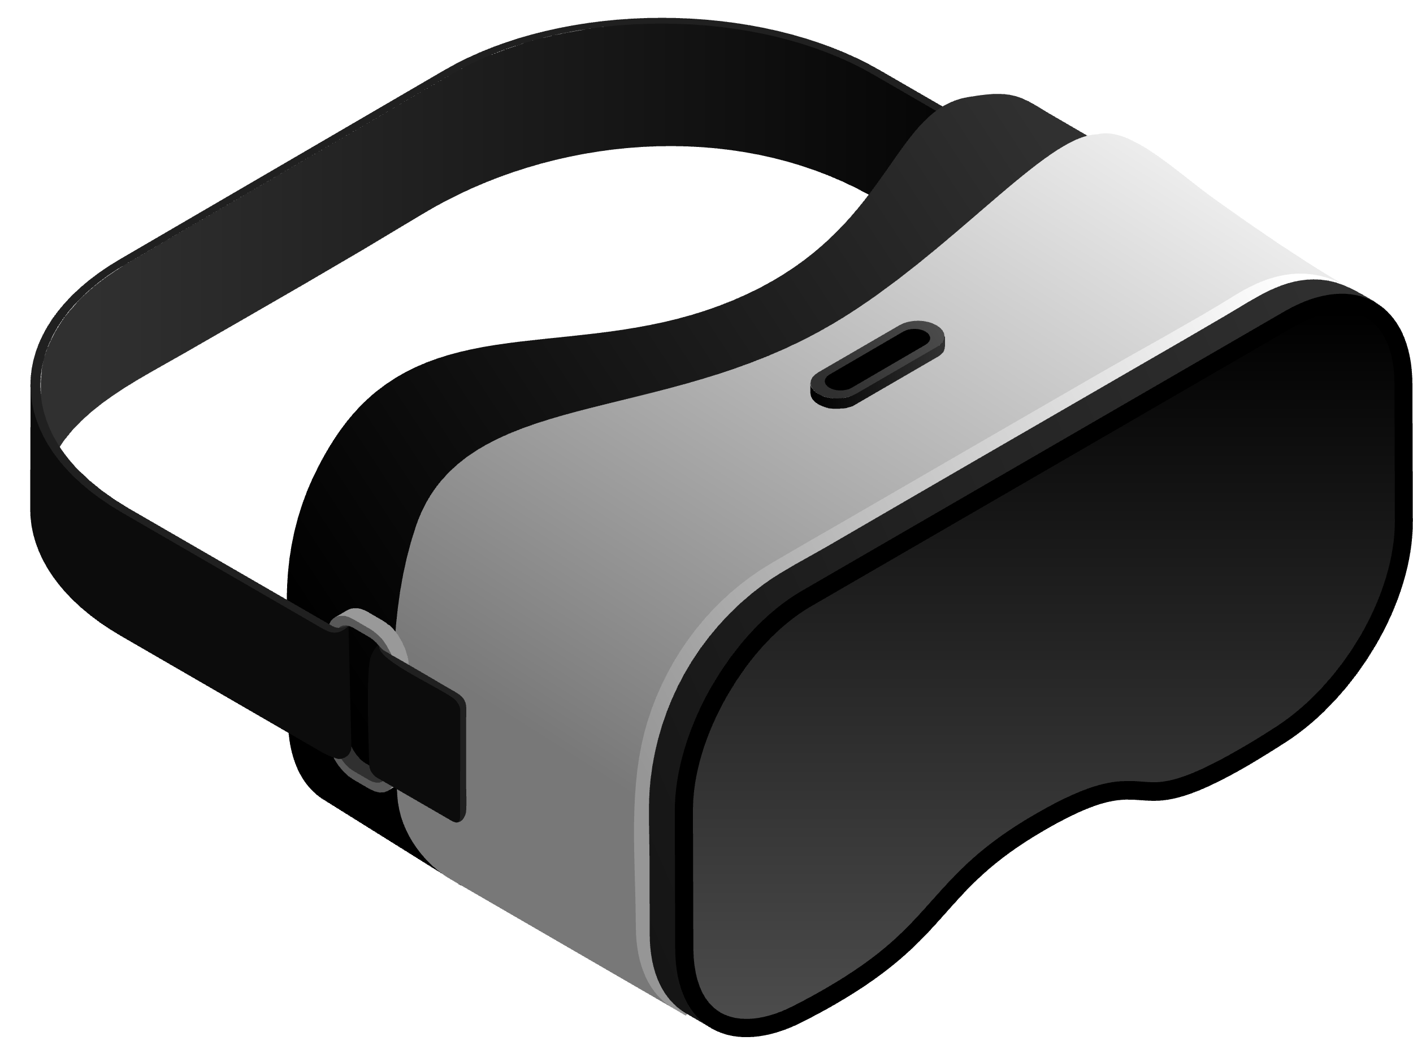
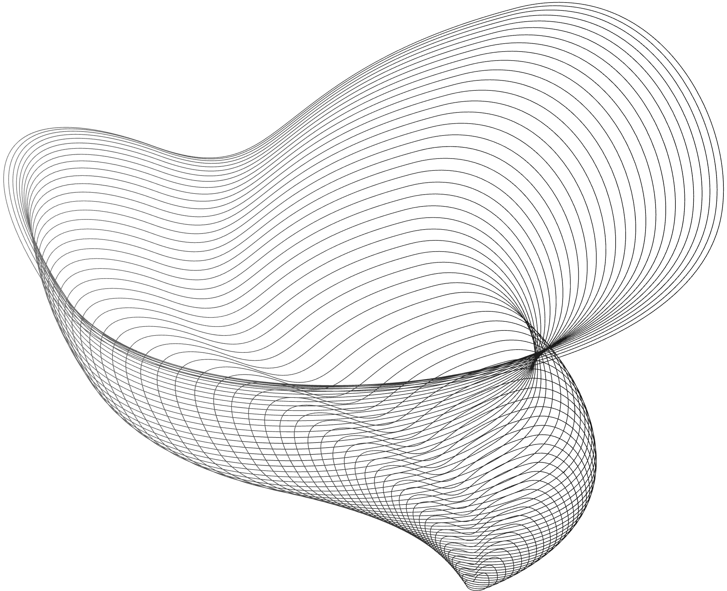
BRAIN-COMPUTER INTERFACES (BCIS)
BCIs represent the next frontier in HCI, enabling direct communication between the brain and computers. This technology has the potential to revolutionize accessibility and control, especially for individuals with severe physical disabilities. BCIs could allow users to operate devices, communicate, or even control robotic limbs using only their thoughts.
AI-ENHANCED PERSONALIZATION
Artificial Intelligence (AI) is transforming HCI by tailoring interfaces to individual preferences and behaviours, offering highly personalized user experiences. AI-driven chatbots and virtual assistants are becoming increasingly sophisticated, providing intuitive support and interaction.

Slide 16


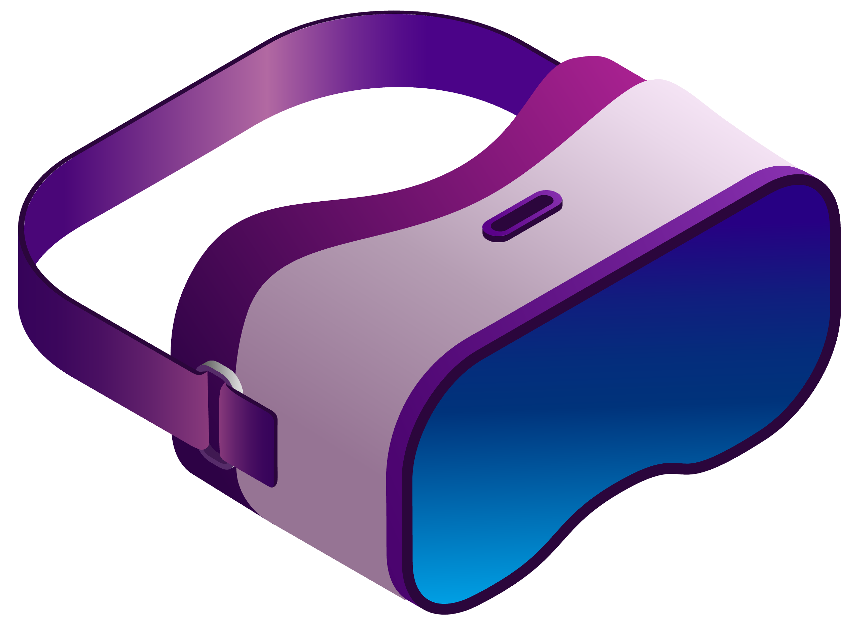

MIXED REALITY (MR)
The integration of AR and VR into a seamless Mixed Reality experience holds promise for gaming, training, and remote collaboration. MR technologies could enable users to interact with both physical and virtual objects simultaneously, creating new possibilities for work and entertainment
HOLOGRAPHIC INTERFACES
Holograms could replace physical screens, offering dynamic and interactive displays for various applications. This futuristic technology has potential applications in teleconferencing, education, and design, providing users with immersive and engaging experiences.

Slide 17



CONCLUSION
Human-Computer Interaction is a vital aspect of modern technology, driving innovation and improving user experiences across industries. By understanding the principles and challenges of HCI, designers can create systems that are both efficient and inclusive. As technology continues to evolve, HCI will play a central role in shaping the future of computing, enabling seamless interaction between humans and machines.

Slide 18
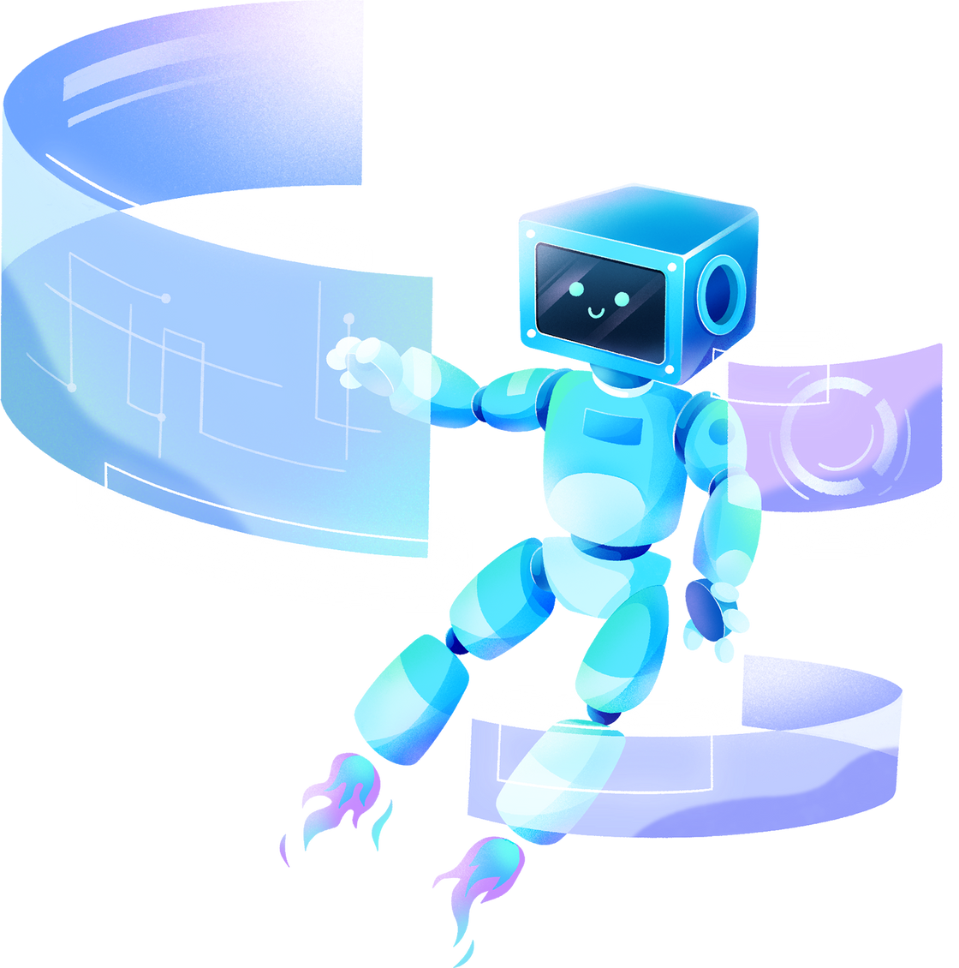
THANK YOU!

